Slide 1

Customer Survey Results

Slide 2
We Surveyed 50 Sauce and spoon customers to learn about their satisfaction with the Tablet rollout and Services offered to test the product quality, services and support offered.
Summary

Slide 3
The team wanted to collect the usage experience of the customers with the tablet and evaluate how comfortable it was to use the tablets throughout the dining process from navigation to payment and checkout. Overall, a positive experience has been reported to indicating the tablet’s ease in placing the order and communication with back Kitchen. Also, the waitstaff had a few to minor challenges in training the users on tablets indicating positive response.
There are some areas where improvement is needed. The team will now prioritize working on these aspects to further enhance the user experience.
Overview

Slide 4
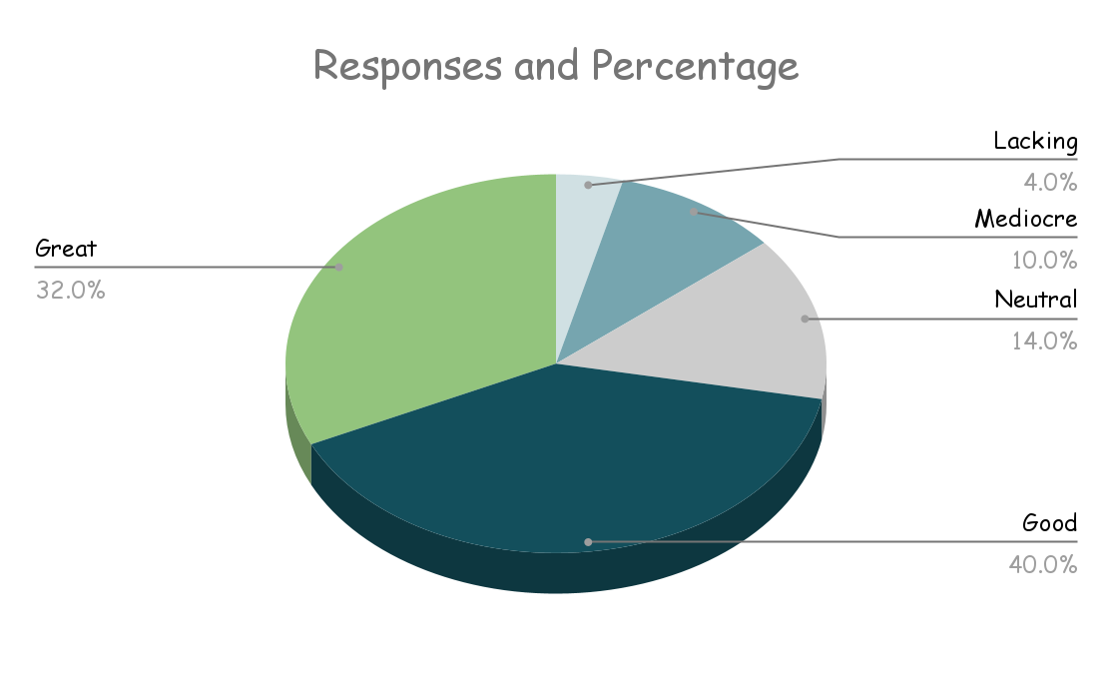
Findings
We have seen a positive overall response from the customer.

Slide 5
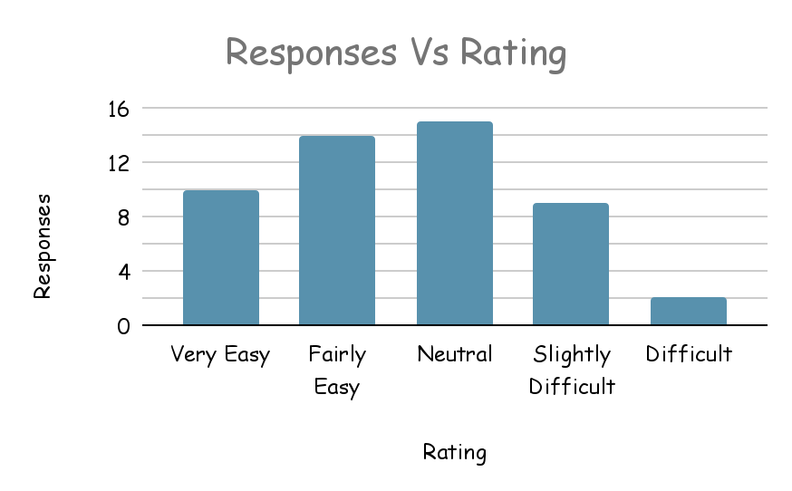
Next Steps
Need to work on the tablet Navigation to get positive response.

Slide 6
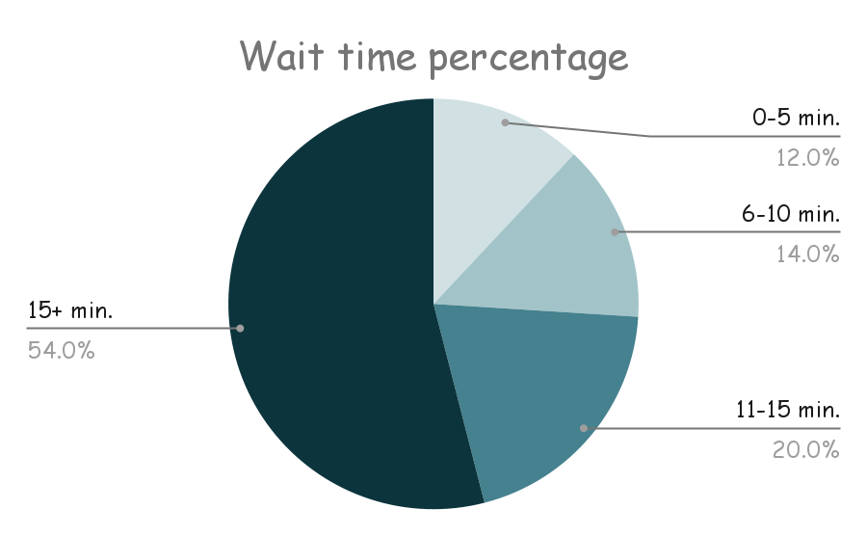
Next Steps
The average wait time needs to be improved as it is aimed at less than 10 minutes

